Slide 1
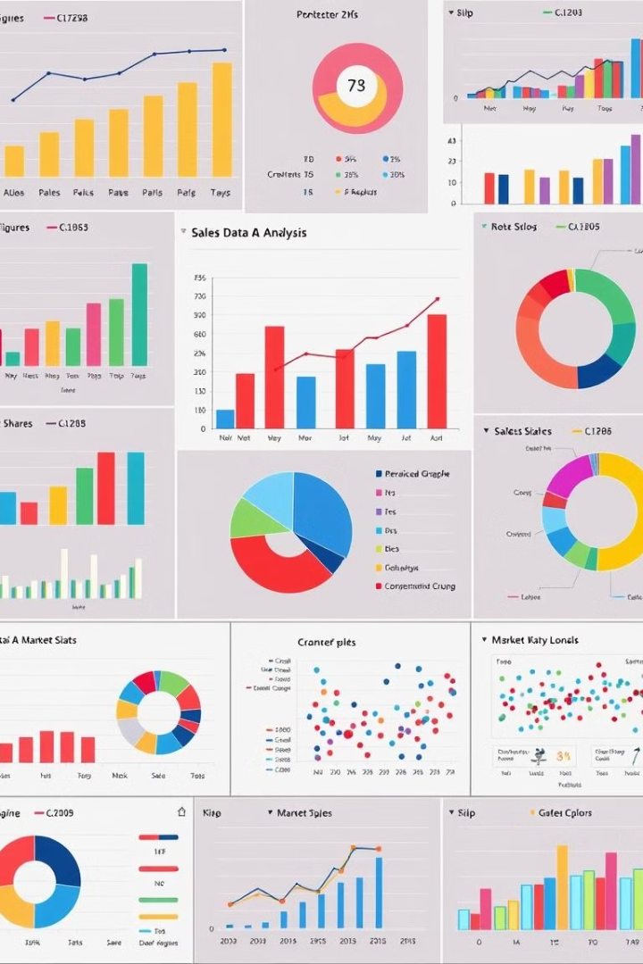

Sales Data Analysis and Reporting for a Retail Chain
This presentation outlines a comprehensive approach to analyzing and reporting sales data for a retail chain, leveraging data insights to optimize operations and drive revenue growth.
by Meghana BK

Slide 2
Introduction and Project Overview
Project Goals
Target Audience
Gain actionable insights from sales data to improve decision-making, optimize inventory management, and enhance marketing effectiveness.
Retail chain management, sales and marketing teams, and decision-makers responsible for driving business performance.

Slide 3

Data Collection and Aggregation
Data Sources
Data Cleaning and Transformation
POS systems, CRM, e-commerce platforms, loyalty programs, customer surveys, market research reports.
Ensure data accuracy, consistency, and completeness for reliable analysis by removing duplicates, standardizing formats, and handling missing values.
Data Integration
Combine data from multiple sources into a single repository for holistic analysis, allowing for cross-referencing and insights across different areas.

Slide 4

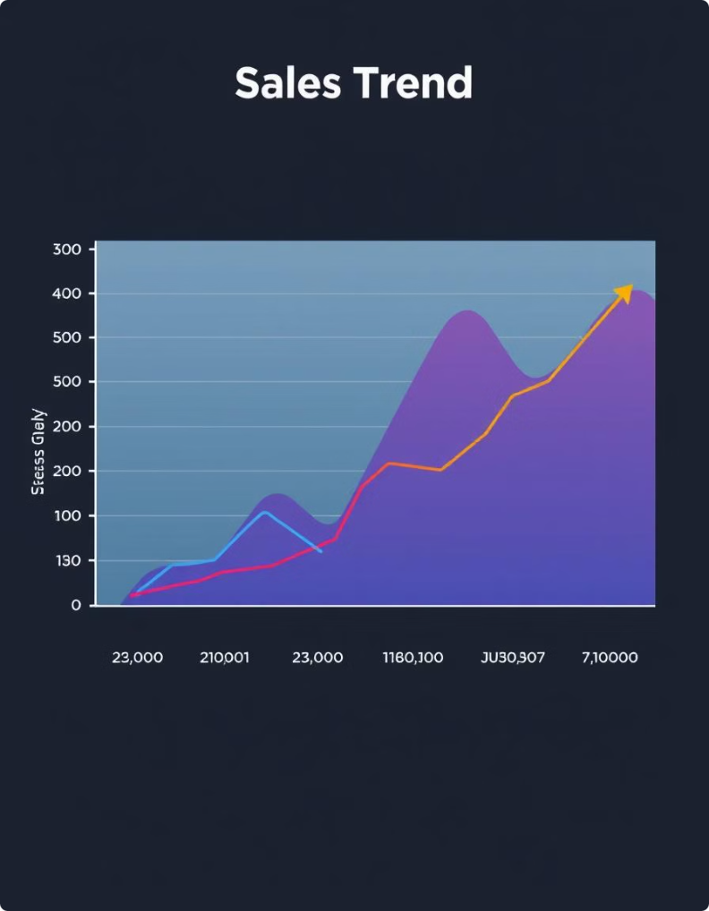
Sales Trend Analysis
1
Historical Sales Patterns
Analyze past sales data to identify seasonal trends, peak periods, and recurring patterns that influence revenue.
2
Sales Growth and Decline
Track sales growth and decline rates to pinpoint periods of strong performance and identify areas for improvement.
3
Product Performance Analysis
Evaluate individual product sales performance to understand which products are driving revenue and which require attention.
4
Competitive Analysis
Benchmark sales performance against competitors to identify opportunities for market share gains and strategic advantage.

Slide 5

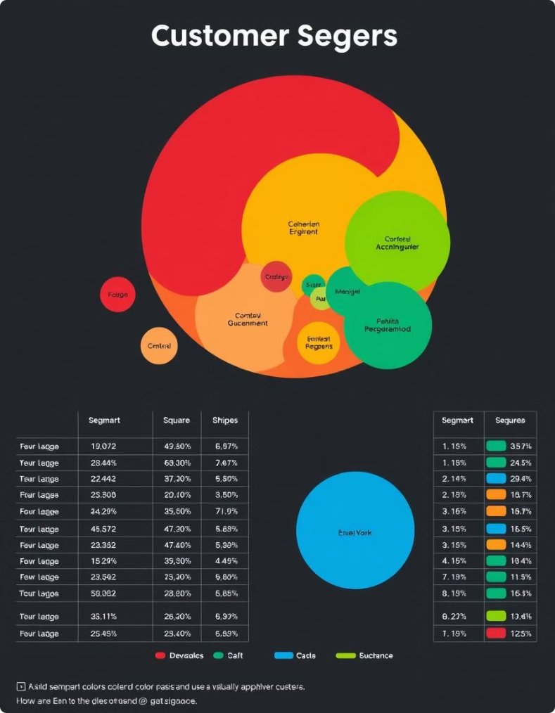



Customer Segmentation and Profiling
Demographics
Purchase Behavior
Analyze customer demographics (age, gender, location, income) to understand the target market.
Identify customer purchasing patterns, product preferences, and spending habits to create personalized marketing campaigns.
Loyalty and Retention
Analyze customer loyalty programs to identify high-value customers and develop strategies to retain their business.

Slide 6




Inventory Management and Optimization
1
Inventory Levels
Demand Forecasting
2
Utilize historical sales data and external factors to predict future demand and adjust inventory levels accordingly.
Stock Turn Rate
3
Analyze the rate at which inventory is sold to identify slow-moving items, optimize stock levels, and minimize waste.
Inventory Optimization
4
Implement strategies like just-in-time (JIT) inventory management to reduce carrying costs, improve efficiency, and avoid stockouts.

Slide 7

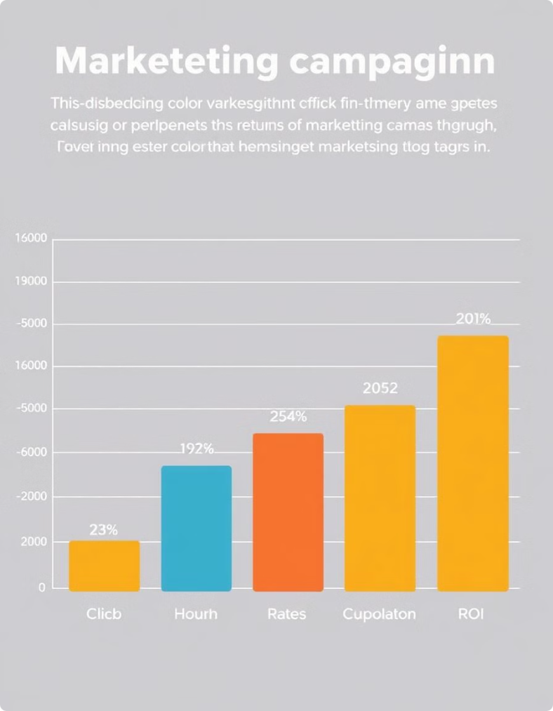



Marketing Campaign Effectiveness
Campaign Tracking
Track campaign performance across different channels to identify successful strategies and optimize future campaigns.
Customer Acquisition Costs (CAC)
Analyze the cost of acquiring new customers to determine the effectiveness of different marketing channels and optimize budgets.
Return on Investment (ROI)
Measure the return on marketing investments to identify campaigns with the highest ROI and allocate resources strategically.

Slide 8


Key Insights and Recommendations
1
2
Boost Sales Growth
Optimize Inventory
Implement targeted marketing campaigns to reach high-potential customer segments and drive sales growth.
Improve inventory management practices to reduce carrying costs and prevent stockouts.
3
Enhance Customer Loyalty
Develop programs and strategies to retain loyal customers and encourage repeat business.

Slide 9

Next Steps and Conclusion
This analysis provides a foundation for data-driven decision-making. The next steps involve implementing the recommendations, monitoring progress, and continually refining the approach to optimize performance.

Slide 10
THANK YOU Team Internship Studio
MEGHANA B K
bkmeghana21@gmail.com

